Slide 1


Clustered vs. Non-Clustered Indexes
Krishna Prajapati

Slide 2
Introduction to Indexes
Indexes are used to speed up the retrieval of data from a
database.
They function similarly to an index in a book, helping to
locate information quickly.

Slide 3
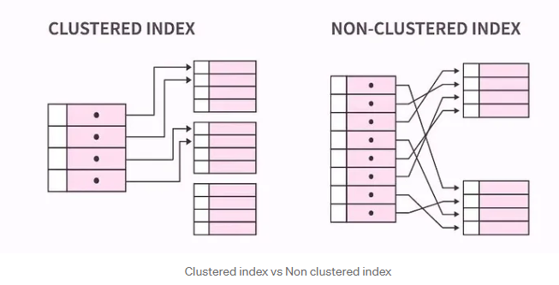
Clustered vs. Non-Clustered Indexes

Slide 4
Definition:
A clustered index determines the physical order of data in a table.
Only one clustered index per table. In a clustered index, the data in the table is actually organized in the order of the index.
Key Characteristics:
The table data is sorted and stored in the order of the clustered index key.
Faster retrieval of rows when accessing sequential data.
Typically created on primary key columns.
Clustered Indexes

Slide 5

Example
Imagine you have a book about animals, and the book is organized by the animals’ names from A to Z. If you want to find information about zebras, you’d go to the “Z” section of the book and find everything about zebras in that order.

Slide 6
Non-Clustered Indexes
Definition:
A non-clustered index does not alter the physical order of the table.
Can have multiple non-clustered indexes on a table.
A separate list that points to where the data is located in the table without changing the original
order.
Key Characteristics:
Contains a pointer to the physical data in the table.
Slower than clustered indexes for sequential access but efficient for random access.
Typically created on columns frequently used in search conditions.

Slide 7

Example
Going back to the animal book, let’s say you have a list at the end of the book that tells you on which pages you can find information about specific topics. So, there might be a list that says: “Zebras — Pages 45, 89, 112.” This list doesn’t change the way the book is organized, but it helps you quickly find pages about specific animals.

Slide 8
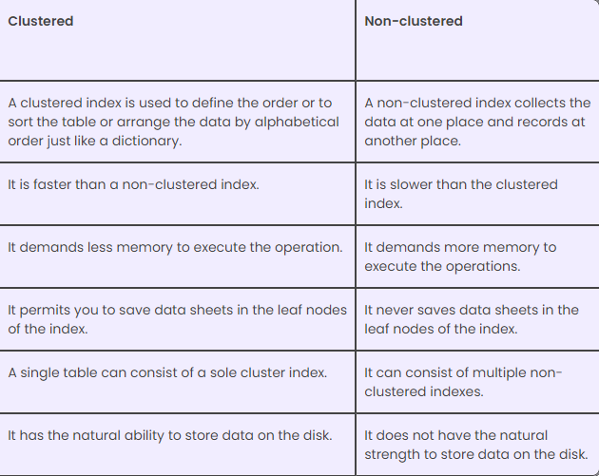
Difference between Clustered and Non-Clustered Index

Slide 9
Thank You

